Slide 1
WikipediaR
A Wikimedia style webscraper
Jonathan Tan

Slide 2
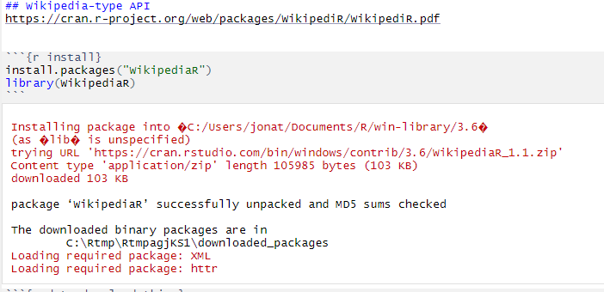

Slide 3
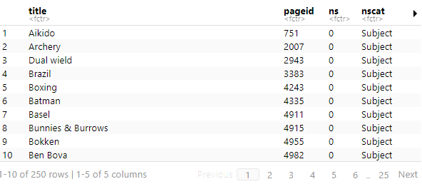
Notes:
List of pages that link to this page

Slide 4
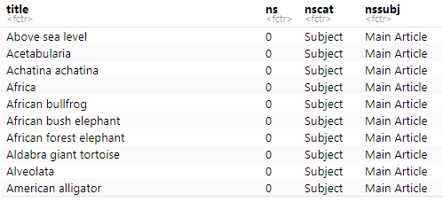
Notes:
List of blue text, could be used to “map” pages?

Slide 5
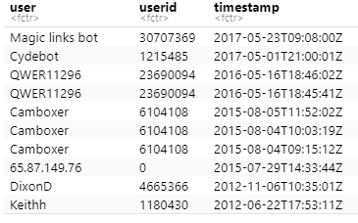
Notes:
Look at when changes were made and by whom

